Slide 1
${\text{PM}}_{2.5}$ and BlackCarbon
3年 地球科学科 大野健

Slide 2
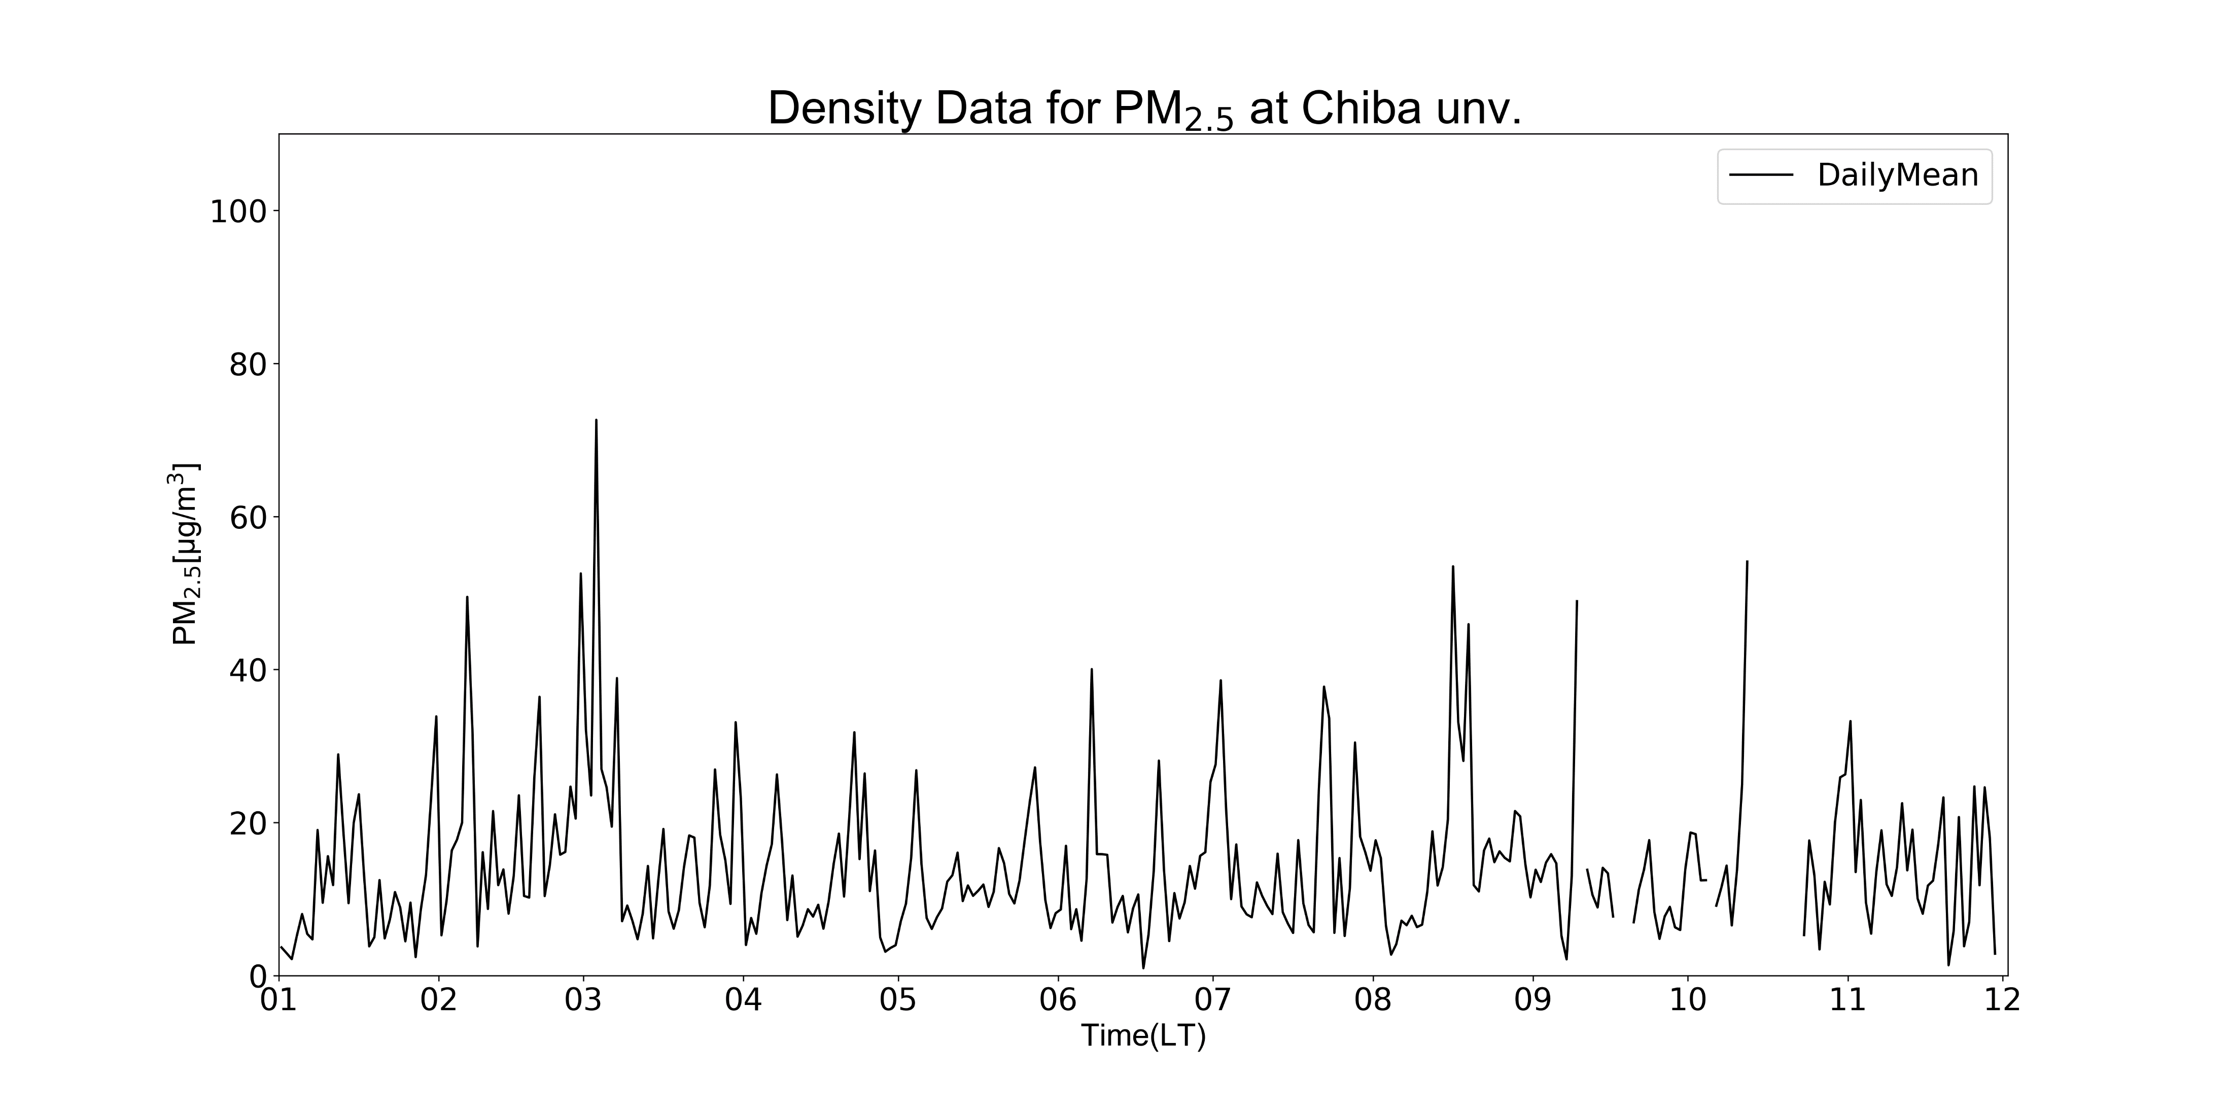
$${\text{PM}}_{2.5}$$
[Figure] The average of dencity data for ${\text{PM}}_{2.5}$ per day( 2019/1/1 0:00 ー 2019/12/2 24:00) at Chiba university(35.625N, 140,104E, 60.0m asl)

Slide 3
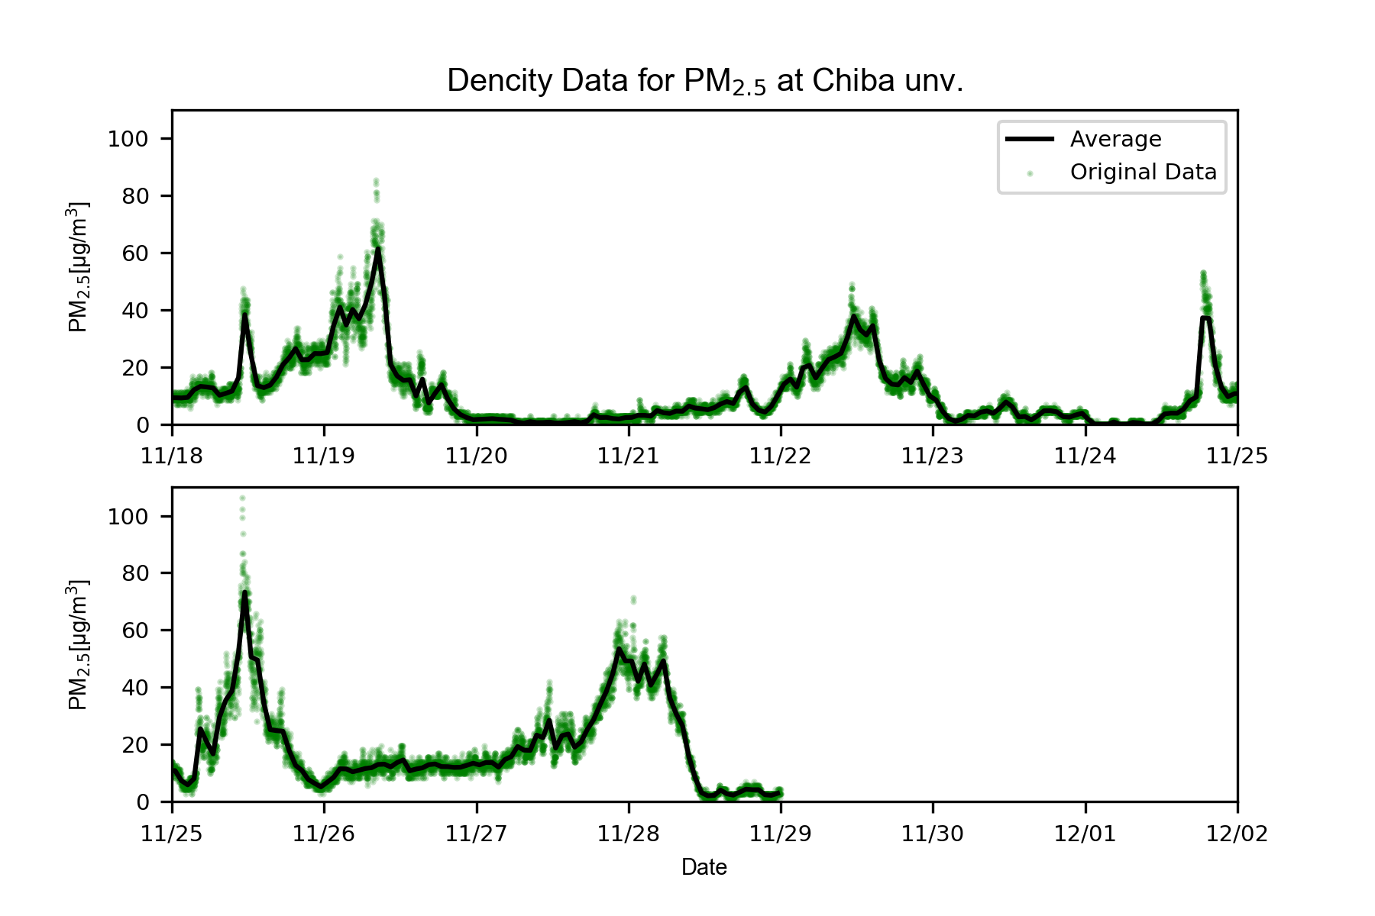
$${\text{PM}}_{2.5}$$
[Figure] The average of dencity data for ${\text{PM}}_{2.5}$ per hour and the original data for ${\text{PM}}_{2.5}$dencity per seconds (2019/11/18 0:00 ー 2019/12/2 24:00) at Chiba university(35.625N, 140,104E, 60.0m asl)

Slide 4
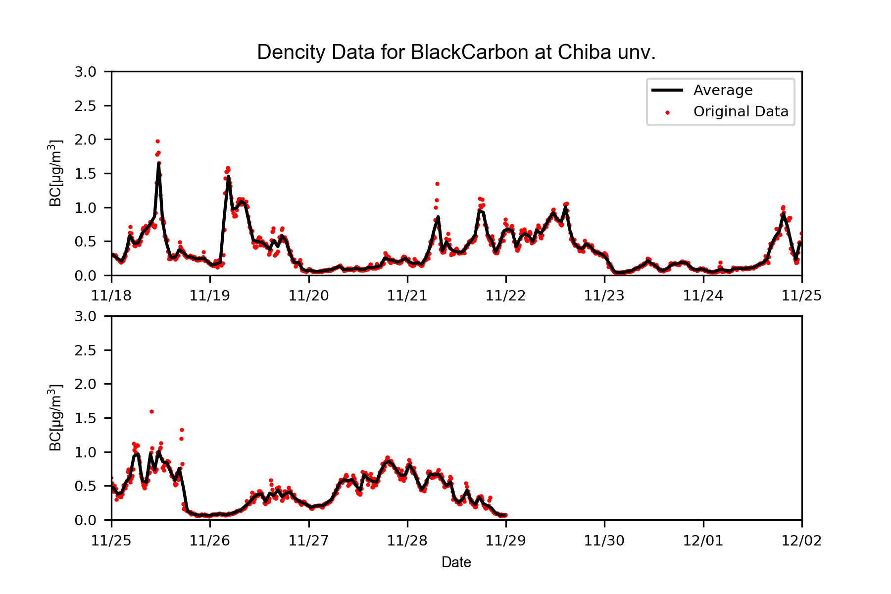
BC
[Figure] The average of dencity data for Black Carbon per hour and the original data for Black Carbon dencity per seconds (2019/11/18 0:00 ー 2019/12/2 24:00) at Chiba university(35.625N, 140,104E, 60.0m asl)

Slide 5
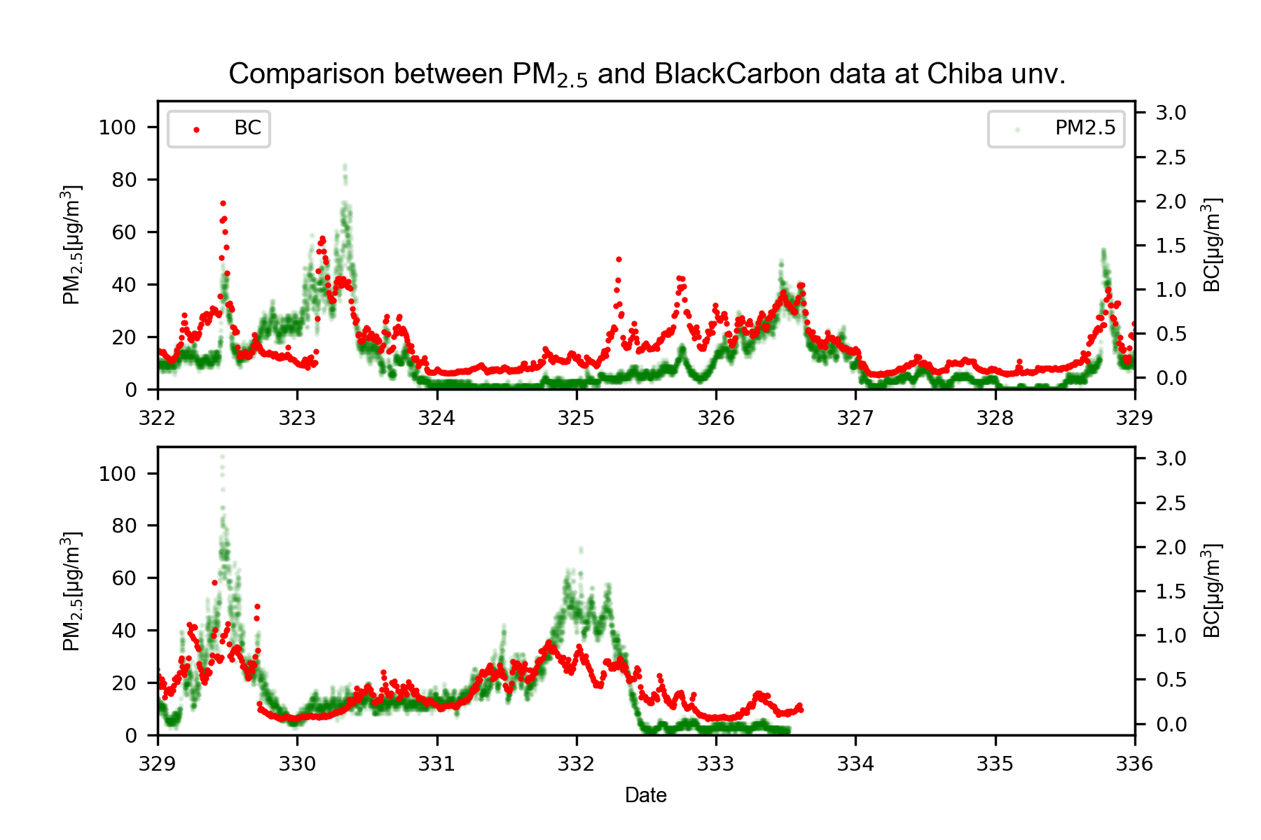
$$BC・{\text{PM}}_{2.5}$$
[Figure] Conparison between ${\text{PM}}_{2.5}$ and Black Carbon data( 2019/11/18 0:00 ー 2019/12/2 24:00) at Chiba university(35.625N, 140,104E, 60.0m asl)

Slide 6
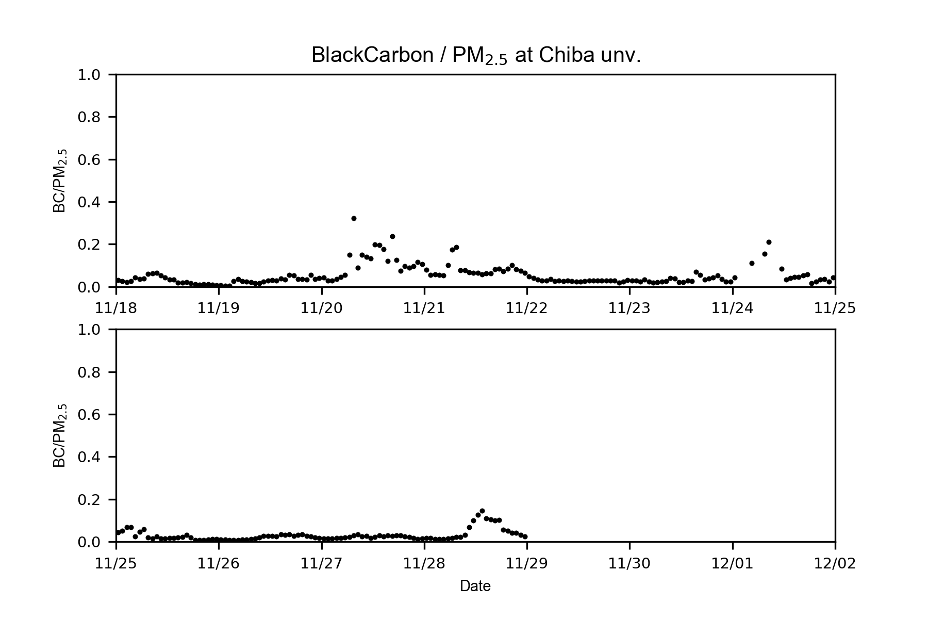
$$BC/{\text{PM}}_{2.5}$$
[Figure] Conparison between ${\text{PM}}_{2.5}$ and Black Carbon data per hour( 2019/11/18 0:00 ー 2019/12/2 24:00) at Chiba university(35.625N, 140,104E, 60.0m asl)

